Slide 1

SMS SPAM DETECTION
Machine Learning
- Allan Sebastian Antony

Slide 2
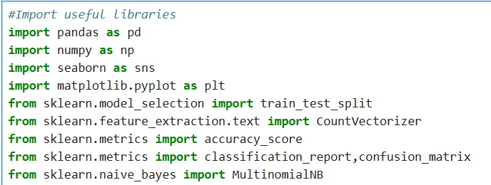
Importing Libraries
Library Imports: Essential libraries like `pandas`, `numpy`, `seaborn`, `matplotlib`, and `sklearn` for data processing, visualization, and machine learning.
Data Splitting: Use `train_test_split` to divide data into training and testing sets to evaluate model performance.
Text Vectorization: `CountVectorizer` transforms text data into a numerical format for model processing.
Model Training: Train the Naive Bayes classifier (`MultinomialNB`) on the vectorized text data.
Model Evaluation: Evaluate the model using `accuracy_score`, `confusion_matrix`, and `classification_report` for performance metrics.

Slide 3
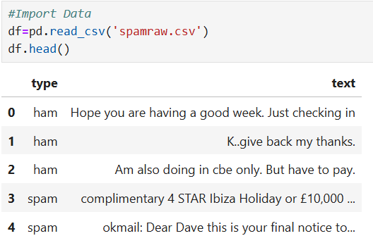
Importing Dataset(csv)
Importing the CSV file and Displaying the first 5 rows using head() function.
The head() function in pandas is used to display the first five rows of a DataFrame.

Slide 4
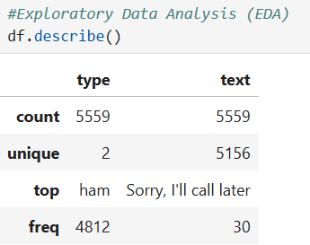
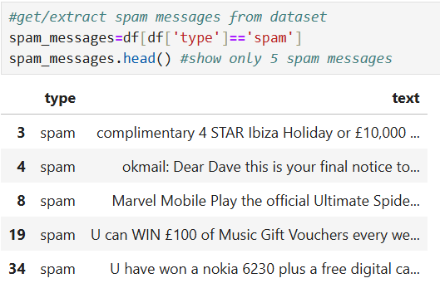
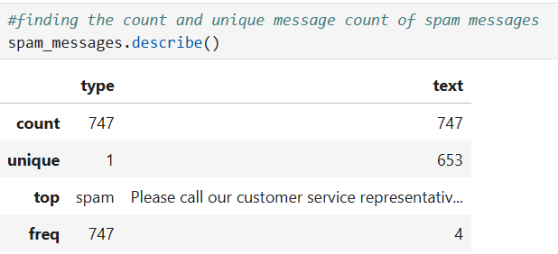
Exploratory Data Analysis (EDA)
Exploratory Data Analysis (EDA) is the process of analyzing and visualizing data to uncover patterns, anomalies, and key insights, guiding further analysis.

Slide 5

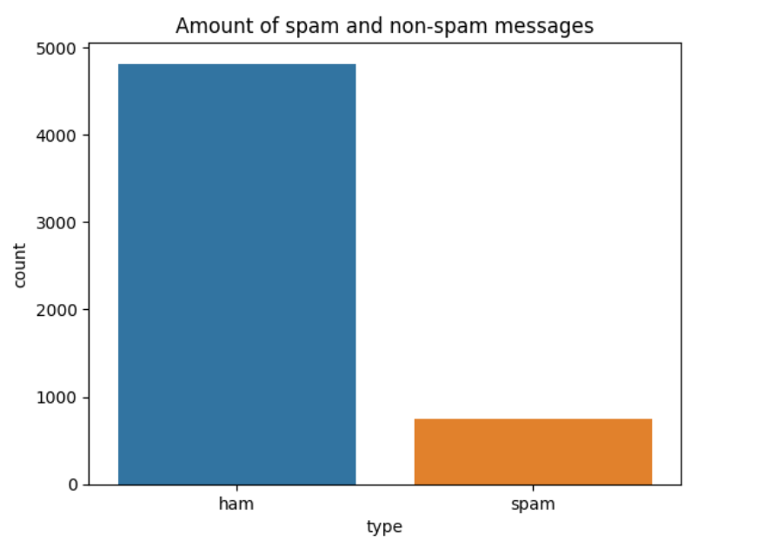
Count plot representation of spam and non-spam messages.

Slide 6
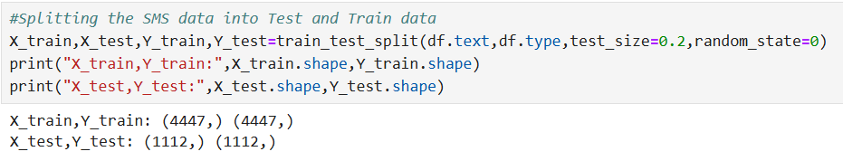
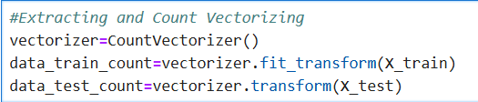
Splitting data into test and train
Extracting and count vectorizing
The Count Vectorizer provides a simple way to both tokenize a collection of text documents and build a vocabulary of known words, but also to encode new documents using that vocabulary.

Slide 7
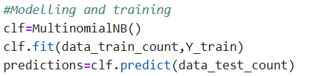
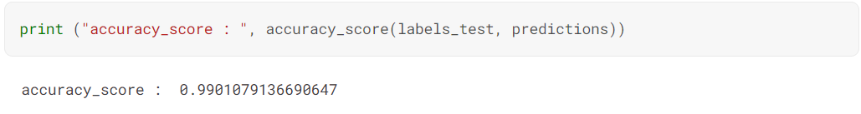
Modelling and training
Multinomial Naive Bayes is a specialized version of Naive Bayes that is designed more for text documents. Whereas simple naive Bayes would model a document as the presence and absence of particular words, multinomial naive bayes explicitly models the word counts and adjusts the underlying calculations to deal with in.
It is a classification technique based on Bayes' Theorem with an assumption of independence among predictors. In simple terms, a Naive Bayes classifier assumes that the presence of a particular feature in a class is unrelated to the presence of any other feature.
Accuracy Score :
Accuracy score measures the proportion of correct predictions made by a model out of all predictions attempted.

Slide 8
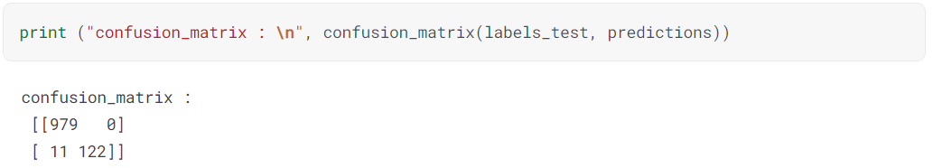
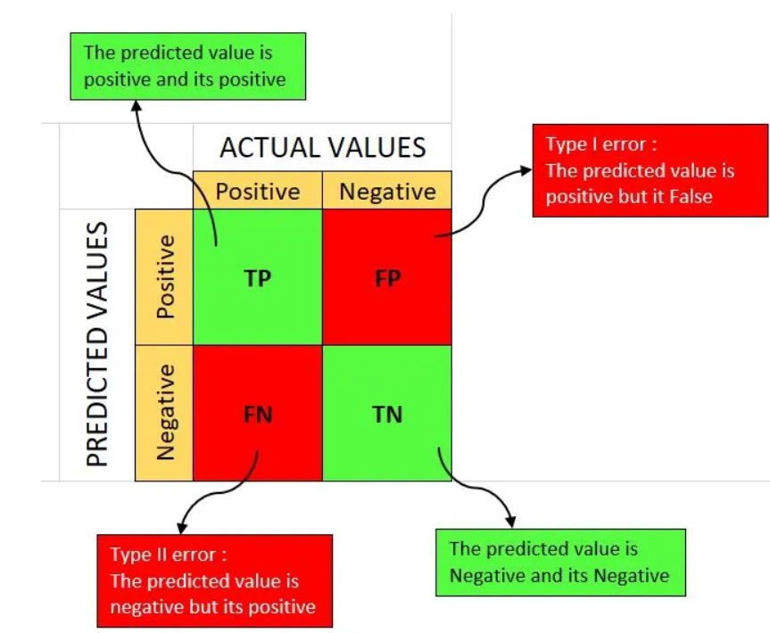
Confusion Matrix:
A confusion matrix is a table that is often used to describe the performance of a classification model (or “classifier”) on a set of test data for which the true values are known. It allows the visualization of the performance of an algorithm.

